Slide 1
Docker Intro

Slide 2
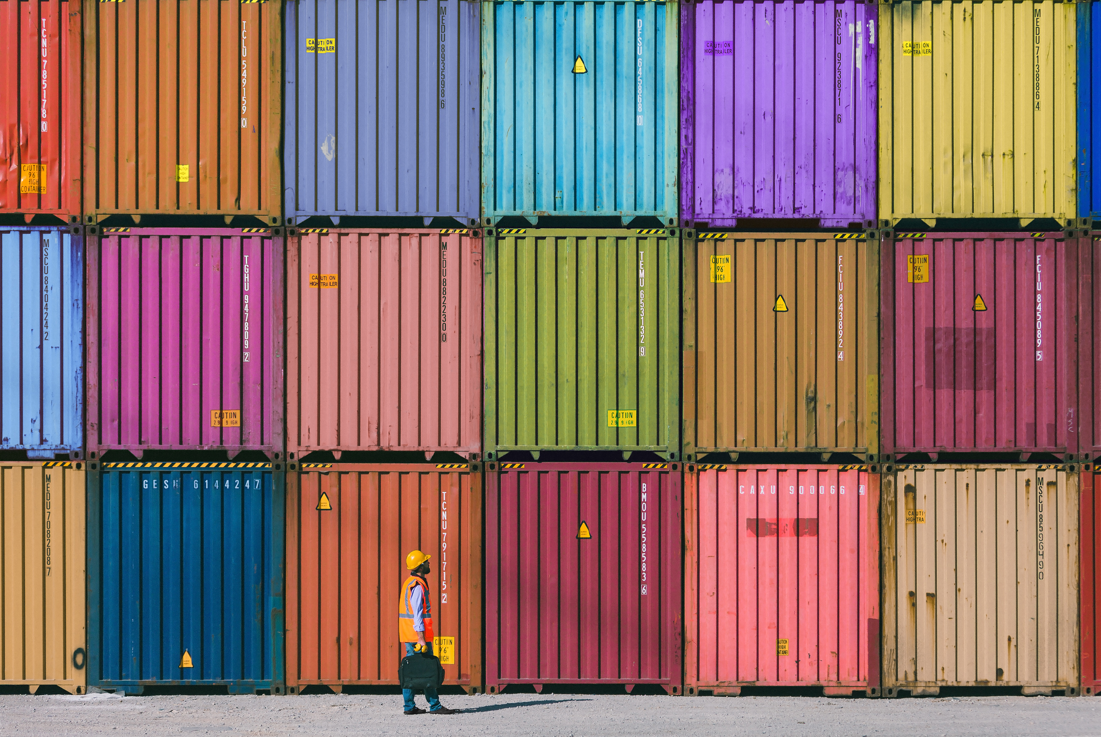
Containers
Used to transport code in a specific environment.
Lightweight alternative to VMs
Less computing power on unnecessary processes.

Slide 3
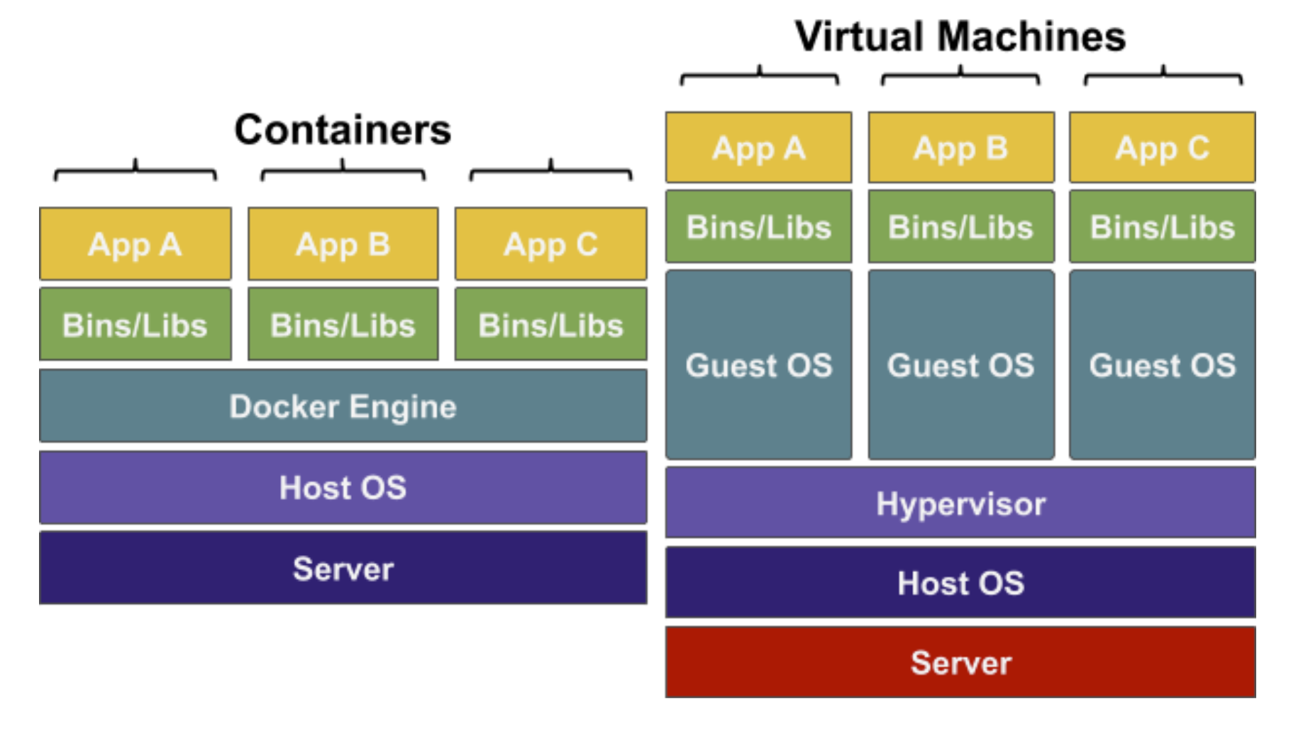
Containers vs Virtual Machines
Server – Physical hardware for the processing power
Host OS – Operating system on the server
Hypervisor – Installed in the Host OS, software to create VMs
Guest OS – Operating system used by the customer
Bins/Libs – Program files for the app to run
App – The app to run
Docker Engine – Containerisation Software on Guest OS

Slide 4
Why developers use containers over VMs
Containers:
Use the same kernel (the core of OS) as the host
Resources are shared between containers if possible
Extremely fast start-up time
Virtual machines:
VMs emulate an entire computer to support an OS
There is complete separation between machines
Far more resources are used to isolate the hosted app
Containers
Vs
vms

Slide 5
Open-source containerisation tool, Well known in the DevOps and Sys Admin space.
Let you configure and replicate environments so you can focus on the code.
Require less computing power as you do not need a guest OS on each container.
Docker can be installed easily with a remote script hosted on https://get.docker.com or can be installed directly on Windows or Mac.
What is Docker?

Slide 6
Docker Images

Slide 7


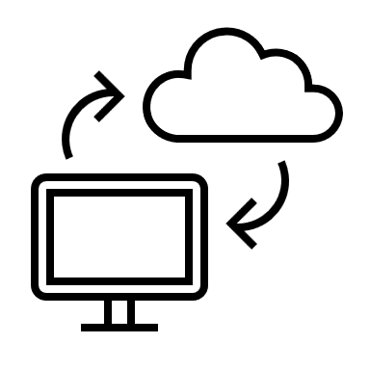
Is a read-only file
A snapshot of the state of a system at a particular point in time
It is like taking an image of your PC. You can then move it to another PC
Docker Image

Slide 8
Image Layers
Images are composed of multiple layers
Layers are read only. To change a layer, create a new one and add it to image
Start with a simple image and add new layers to create new images.
Each Dockerfile instruction creates a new layer.
Layers are cached, so changing a line in Dockerfile rebuilds only the layer affected by that change
nginx
nginx code
Other stuff
ubuntu
FROM alpine:3.4
RUN apk update
RUN apk add vim
RUN apk add curl

Slide 9
Registry - DockerHub
Images are typically stored in remote registries
Can be used by other people for their CI/CD
Docker Hub is the default image registry https://hub.docker.com/
The Docker CLI works with Docker Hub Login with docker login

Slide 10
Docker Containers

Slide 11
Containers are what our images run in They run in the same way across any device with Docker.
Containers have the following info:
- Container ID - Image - Command - Created - Status - Ports - Names
Containers

Slide 12

Containers in CI
Containers allow you to simultaneously run your codebase in a repeatable environment.
Containers run the same in any machine, Can replicate part of the production environment.
Saves time and human error
Integration Test Environment
Code base
CoolApp:1.2
Credentials + environment
CI Server
Version Control System
Unit Test Environment
Docker
CoolApp:1.2
Credentials + environment

Slide 13
When running our application inside a container, its important to be able to interact with them individually and collectively.
There are limited commands to running and managing a number of containers. Container orchestration tools such as Kubernetes make this job easier.
A few container commands
Command | Function
ps ps -a | Lists all running containers -a shows all containers, running or not
logs | Returns logs of the container
exec | Connect to an individual terminal via a shell
start | Starts a stopped containers (Run creates and starts container)
stop | Stops a running container
rm (-f) | Deletes a container (-f forces it to be removed)
rename | Renames a container

Slide 14
Lab
Please do the lab
1-Docker basics.docx

Slide 15
Dockerfile

Slide 16
We can create custom Containers using any template images and any other instructions with a Dockerfile
Is a type of file (no extension) that is read by Docker and contains specific instructions to build a container
Dockerfile

Slide 17
Dockerfile Intermediate Instructions
Dockerfile offer a large library of commands to configure your environment Generally, a Dockerfile will have at least four commands in Key Value format.
The file MUST start with a FROM and generally the final process is ENTRYPOINT.
Command | Description
FROM | Base image, what to build image starting from
RUN | Execute a specific command on container
CMD | Defines the main process OR default vars for ENTRYPOINT
ENTRYPOINT | Main process for the container to run on start up
LABEL | Metadata for the image
EXPOSE | The ports the container listens on (Only documents, doesn’t actually use this port)
ENV | Sets an Environment variable
COPY | Copies files into the image
ADD | Copies files (can take in a URL)
WORKDIR | Sets the working directory for RUN, CMD, ENTRYPOINT, COPY, ADD
ARG | Defines variables for use in build time

Slide 18
Lab
Please do the following labs
2-Dockerizing a Node Using DockerFile.docx
And
3-Docker MySQL Using DockerFiles.docx

Slide 19
Docker Compose

Slide 20
.
Compose tool enable you to define and run multiple Docker with a single command.
Uses a single configuration file to specify deployment
Can create collections of containers
Is a great tool for spinning microservice apps
What is Docker compose

Slide 21
Compose CLI
docker-compose up Start up all the services declared in the configuration
-d Run the containers in the background
--build Build images before starting containers
--scale [SERVICE]=[NUM] Can specify the number of containers
docker-compose down Stops the services created up.
--rmi Removes images.
docker-compose build Builds the images without running any containers.
--parallel Builds all the images at the same time to save time when images do not depend on each other

Slide 22
Compose CLI
docker-compose ps Displays the running containers started by Docker Compose
-a Show all containers, including stopped ones
docker-compose exec Execute a command in a running container
-d Run the command in the background
-e Set environment variables
docker-compose logs Display the log outputs from the running services
docker-compose push Push the images used for the services to a registry

Slide 23
Lab
Please do the following lab
4-Docker Compose.docx

Slide 24
Communication

Slide 25
Communication is vital for containers to interact with each other and external systems.
You can create a network between your dockers
Enables each docker to call other dockers’ APIs
Vital mechanism for Microservices
Docker communication

Slide 26
Several form of networks can be set up
Bridge Networks:
Default mode in Docker.
Allows communication between containers on the same Docker host.
Overlay Networks:
Extends communication across multiple Docker hosts.
Enables communication between containers on different hosts.
Communication Modes

Slide 27
Networking…
Host Networks:
Containers directly access the networking stack of the Docker host.
Bypasses Docker's network isolation.
External communication is done via port mapping
Communication Modes…

Slide 28
Summary
Docker communication enables flexibility and scalability of containerized applications.
Bridges internal communication between containers and external systems.
Essential for deploying applications across diverse environments

Slide 29
Lab
Please do the following lab
5-Docker Networking.docx

Slide 30
Docker Swarm

Slide 31
Container Orchestration
Docker CLI can containerise apps and deploy them with ease
In a production serving 1000’s of users, using the CLI isn't a feasible option
To deploy and manage containers at scale you’ll need to use a container orchestration

Slide 32
Benefits of Container Orchestration tools
Easily scale containers (up/down)
Control how many instances of a container are running, Easily increase the scale of our operation when the user base increases
Increased redundancy and improved resiliency
if one instance of your container dies, there will be others to take its place
Deploy containers across multiple machines (nodes)
make use of more compute resources and improve system resiliency
Load balancing between containers to network traffic across nodes
Dynamically re-allocate containers across nodes -
if a node dies, containers on that node will be reallocated to the remaining nodes automatically
Rolling updates can be done without stopping or restarting any containers
Updates can be implemented without requiring any downtime for the end user

Slide 33
Manager Nodes
This node is where we can execute commands for managing the Swarm, including the nodes inside it.
You may have more than one Manager node in a cluster.
Worker Nodes
The worker's job is to just run containers, complying with the manager nodes requests.
Containers for deployed services will be automatically provisioned evenly across worker nodes.
When new worker nodes are added, deployed services must be updated or recreated to take advantage of the new nodes.
Docker Swarm
A swarm is a group of containers running across a group of machine (nodes) called a cluster
Is Docker's in-built container orchestration tool.
No extra installation requirements
Swarm has many components:
clusters, manager nodes, worker nodes and a network mesh for ingress traffic.

Slide 34
Manager Nodes
This node is where we can execute commands for managing the Swarm, including the nodes inside it.
You may have more than one Manager node in a cluster.
Worker Nodes
The worker's job is to just run containers, complying with the manager nodes requests.
Containers for deployed services will be automatically provisioned evenly across worker nodes.
When new worker nodes are added, deployed services must be updated or recreated to take advantage of the new nodes.
Communication between nodes
Nodes within a cluster communicate with one another
Balances the containers within the swarm across the cluster making maximum use of compute resources Also ensuring no node is being overworked
Nodes in the cluster are either manager nodes or worker nodes.
When a cluster is initialised on a node, it becomes the cluster's first manager.
It can then produce a join token to allow more manager or worker nodes to join the cluster

Slide 35
Lab
Please do the following lab
6-Docker Swarm.docx

Slide 36
Hope you enjoyed our session on Dockers

